Slide 1

Data Profiling and Progress Monitoring with Data Analytics Technique for...
A Non Gov’t Organization Established by the Archdiocese of Davao

Slide 2
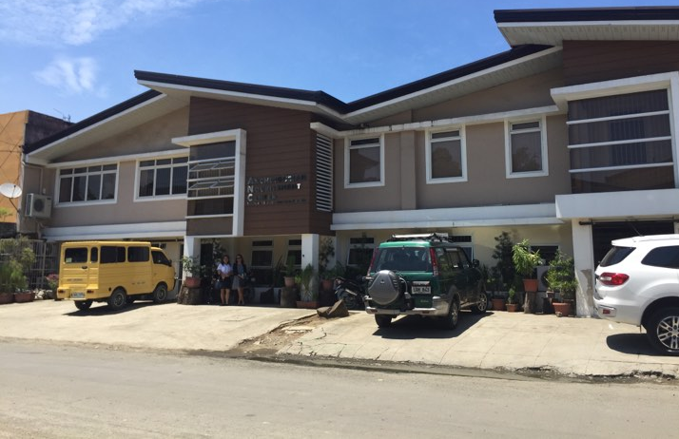

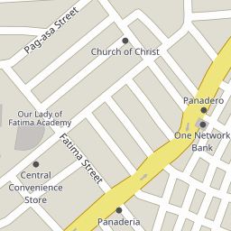
Pag-Asa St, Poblacion District, Davao City, Philippines

Slide 3

Pag-Asa St, Poblacion District, Davao City, Philippines

Slide 4

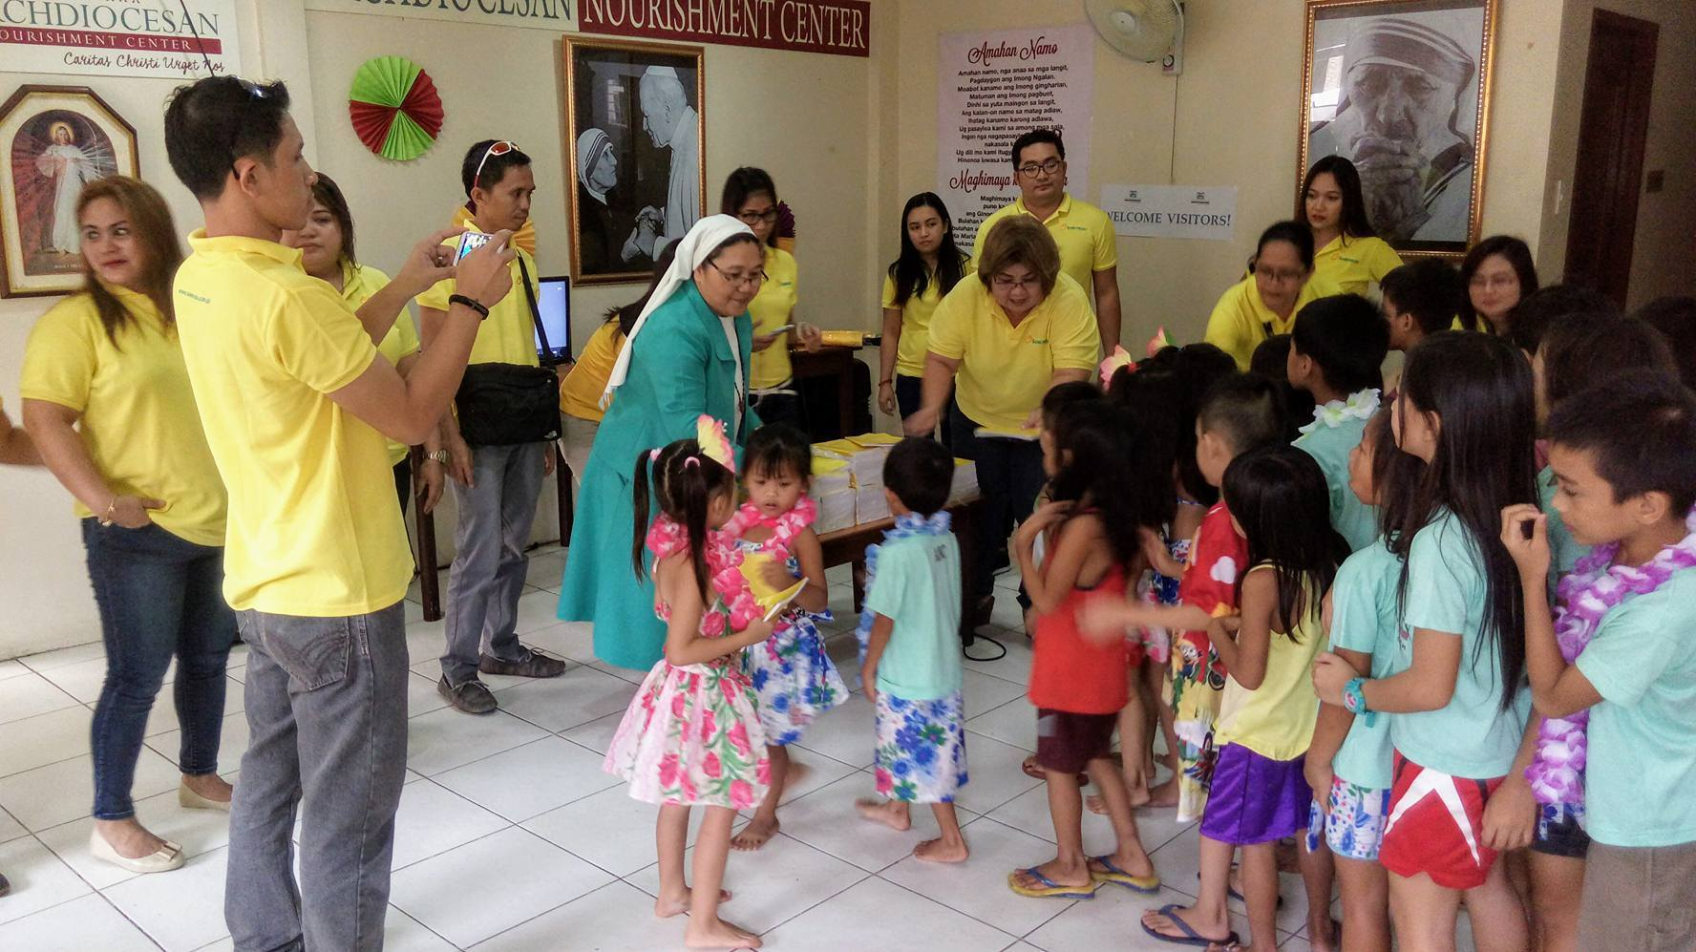
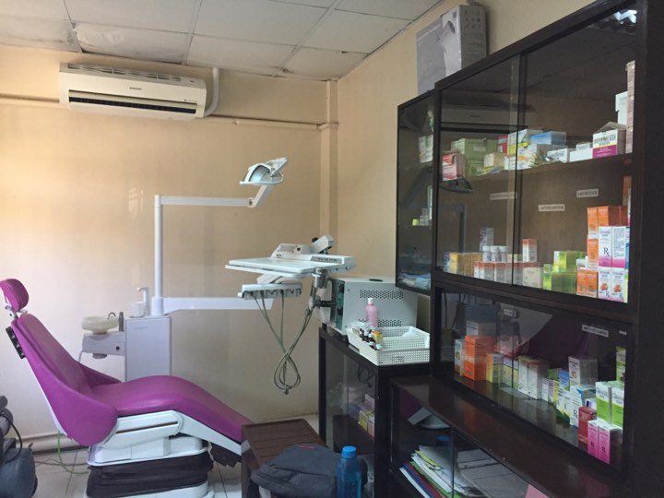
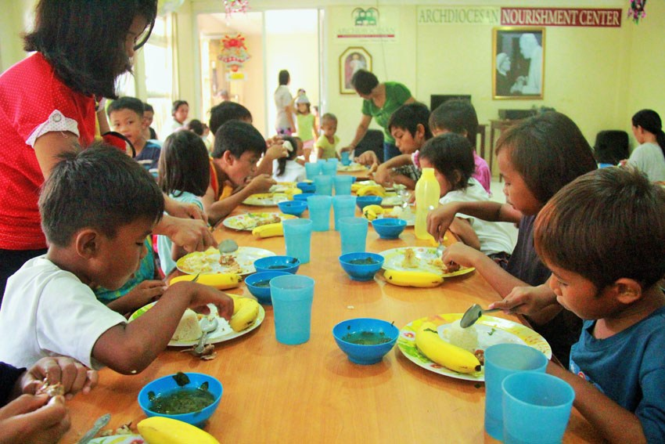

Slide 5

Specific Objectives
Analyze the medical and nutritional status
of the Archdiocesan Nourishment Center (ANC)
children using Data Analytics Techniques.
Generate recommendations for possible treatment and proper nutritional diet using Decision Support System.
Generate statistical reports in graphical representation using Highcharts Interactive JavaScript charts.
Notify the medical staffs regarding children that requires immediate medical attention, prioritization and medical schedules using JQUERY tool.
Notes:
Difficulty in monitoring child’s nutritional progress
They record details such as height, weight, appetite, water intake, bowel movement and general hygiene, having all these details and having a lot of children to cater give them a hard time to organize and keep all the records. In every check-up, finding the previous record of each children consumes a lot of their time, there are also instances where the records are misplaced or loss so it is difficult to monitor their nutrition.
Difficulty in determining and comparing statistic reports
They do determine and compare statistic reports such as range of boys and girls enrolled in their nutritional program, diseases or illnesses by age in months, number of children with diseases, location affected by diseases, number of children that has improved or worsen their nutritional status, and comparison of diseases in every child. however it is difficult for them because of so much time and resources needed to perform the whole processes considering that they have lots of file stored in separate file storages.
Difficulty in analyzing medical and nutritional status of children
It is difficult for them to know if a certain disease of a child is recurring or not because they find it difficult to keep a report or disease history in order due to multiple files they store in separate file storages. It is also difficult for them to analyze why the BMI of a child increases or decreases and what are the possible causes for these children’s nutritional problems.
Difficulty in determining children that requires the most medical attention and are in critical alert status.
There are cases when a child requires immediate medical attention due to various reasons like worsen nutritional status, illnesses, loss of appetite, etc. Sometimes, they have difficulty in monitoring such cases because each of these records requires assessment by looking at their previous data which are stored separately. Moreover, they currently don’t have a notification device or technology for such cases

Slide 6
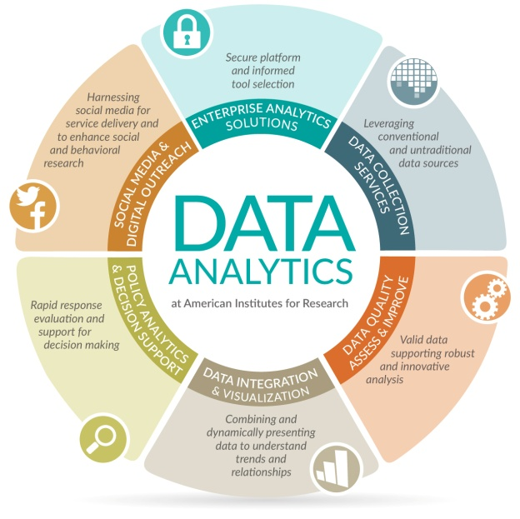
Data Analytics
Definition - What does Data Analytics mean?
Data analytics refers to qualitative and quantitative techniques and processes used to enhance productivity and business gain. Data is extracted and categorized to identify and analyze behavioral data and patterns, and techniques vary according to organizational requirements.
Data analytics is also known as data analysis.
Source: https://www.techopedia.com/definition/26418/data-analytics

Slide 7
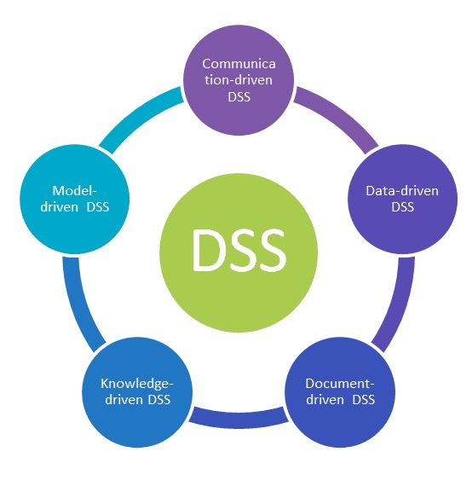
Decision Support System (DSS)
Definition - What does DSS mean?
Decision Support System (DSS) is a computer program application that analyzes business data and presents it so that users can make business decisions more easily. It is an "informational application" (to distinguish it from an "operational application" that collects the data in the course of normal business operation).
Source: http://searchcio.techtarget.com/definition/decision-support-system

Slide 8
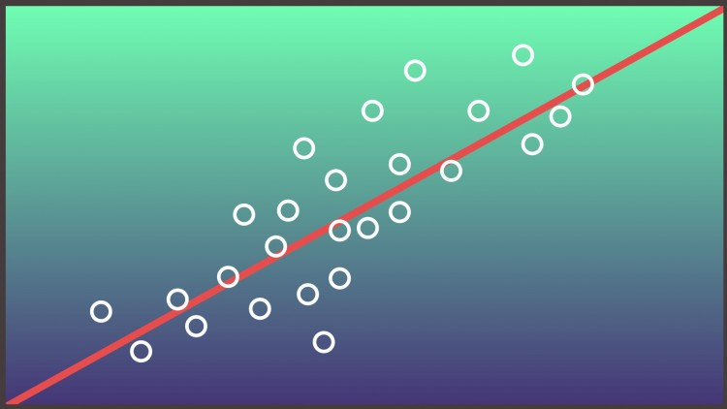
Regression Analysis
What is Regression Analysis
Regression analysis is a way of mathematically sorting out which of those variables does indeed have an impact. It answers the questions: Which factors matter most? Which can we ignore? How do those factors interact with each other? And, perhaps most importantly, how certain are we about all of these factors?
Source:
https://hbr.org/2015/11/a-refresher-on-regression-analysis

Slide 9
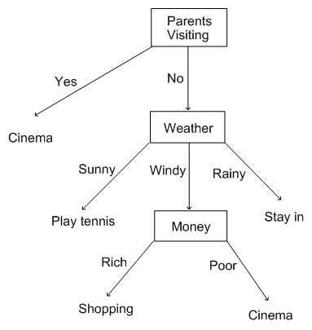
Decision Tree Analysis
What is Decision Tree Analysis
A decision tree (as a predictive model) to go from observations about an item (represented in the branches) to conclusions about the item's target value (represented in the leaves). It is one of the predictive modelling approaches used in statistics, data mining and machine learning.
Source:
http://study.com/academy/lesson/what-is-a-decision-tree-examples-advantages-role-in-management.html

